Slide 1
The Sensational Thinking Project
Tara Tordoff Occupational Therapist

Slide 2
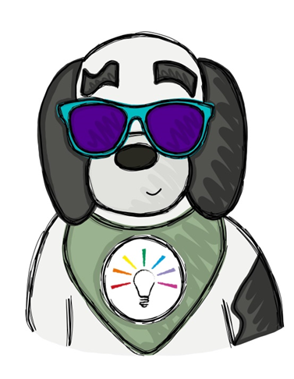
Aims
We will briefly discuss:
Bobby – our mascot!
The development of the project from the start.
The project impact.

Slide 3
The history of the Sensational Thinking Project
Clinical Audit
Need for Sensory support / prevalence of sensory needs
Sensory assessment & educational support
Sensational Thinking Project

Slide 4
Identifying the need
Volume of sensory referrals
2012-2017
Year | Number of referrals
2012 | 36
2013 | 48
2014 | 65
2015 | 78
2016 | 125
2017 | 137

Slide 5
Meeting the need
Team capacity
Sensory integration training, levels 1-3.
Staffing – using the data to highlight the need.
Assessment
Sensory processing measure - home & school
Assessment report
Intervention
Educational support to caregivers, school, professionals.

Slide 6
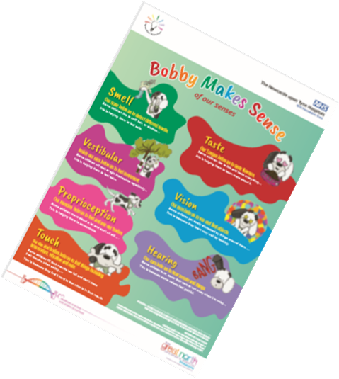
Project impact & where we are at now
Sensational Home
Sensational Practitioner
Sensational School

Slide 7
Any questions? Please take time to complete the feedback form

Slide 8
References
Sensory integration – theory and practice (Bundy & Lane 2020).
Sensory integration network - Sensory Integration Education - Transform Lives
The Sensational Thinking project - Newcastle Hospitals NHS Foundation Trust (newcastle-hospitals.nhs.uk)

